Slide 1
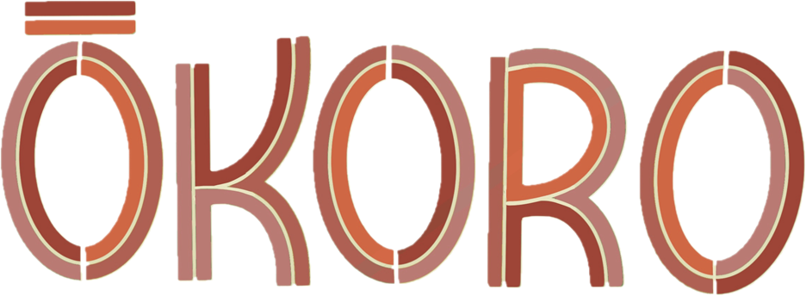
Insights: Wānanga Kaimahi Māori

Slide 2

“
Mehemea ka moemoea ahau, ko ahau anake. Mehemea ka moemoea tātou, ka taea e tātou
If I dream, I dream alone. If we dream as a collective, we can achieve our dream
Te Puea Hērangi
(1883-1952)

Slide 3

Kupu arataki - introduction
Kaimahi Māori from across the Archives, National Library, and Ngā Taonga Sound & Vision were invited to come together for whakawhiti kōrero me whakawhiti whakaaro to help shape and inform the Te Ara Tahi shared vision for the future and new ways of working for our institutions.
Ōkoro responded to feedback from kaimahi Māori for an opportunity to include Māori ki te Māori perspectives.
The delivery and style of the wānanga was founded on kaupapa Māori theory.
A total of two wānanga were held and timing aligned to the maramataka cycle, informed by the knowledge of Rereata Makiha: Ōkoro – Monday 4 April, and Tamatea ā Hotu – Wednesday 6 April.
The duration of each wānanga was 3 hours; aiming to strengthen whanaungatanga across our institutions, gain a greater appreciation of what we all do, and advance te ao Māori ways of knowing, being and doing, for the benefit of future generations and a stronger, collaborative heritage sector.
Both wānanga were facilitated by Te Hīnaki – comprised of Kaihautū Māori, Archives; Kaihautū Māori, National Library; Pou Ārahi, Ngā Taonga Sound & Vision; and the Director, Mātauranga Māori. Kōrero was captured by participants and dedicated scribes in chat and on Miro boards; and live illustrations with expertise from two kaimahi from the League of Live Illustrators.

Slide 4

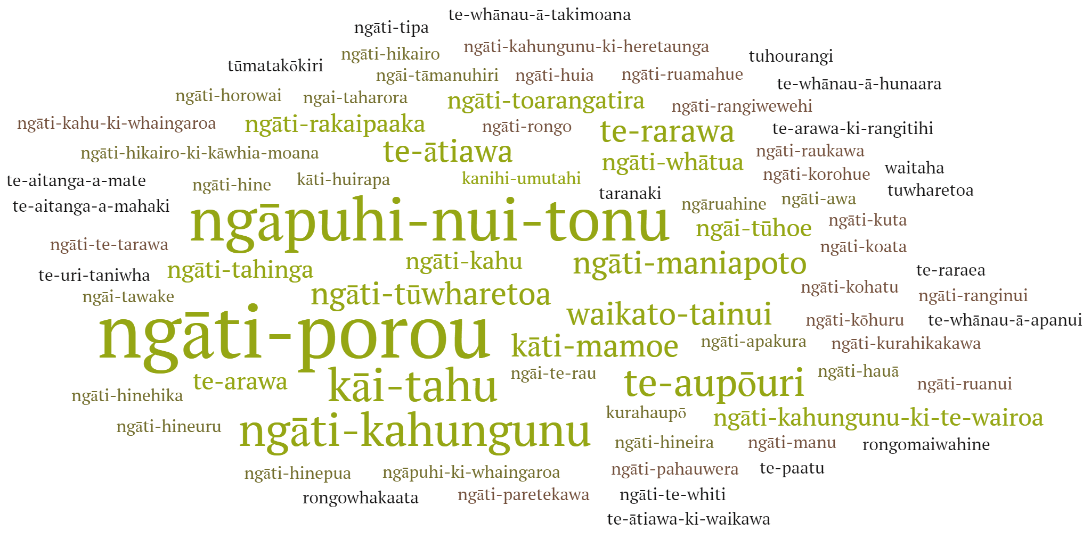


Tirohanga whānui - overview
40
Kaimahi Māori attended
122
Number of whānau, hapū, iwi represented
62
Insight illustrations created

Slide 5



Ngā whakaritenga - outline
There were two parts to the wānanga that used breakout rooms, Miro, and hā ki roto, hā ki waho meditation.
Part 1: Whanaungatanga – understanding ko wai koe?, nō hea koe?, taonga and their connection to, and understanding of, mātauranga Māori. This enabled kaimahi to connect through tātai whakapapa (hapū/iwi) and whakaaro Māori, before engaging in a deeper discussion.
Part 2: Whakawhiti kōrero, whakawhiti whakaaro – three segments, me huri whakamuri, ka titiro whakamua, ka tupu ka ora.
  Me huri whakamuri – looking back; locating yourself with your whānau, hapū, iwi in a position of thriving prosperity and wellbeing, what has this looked and felt like? What would we carry forward?
  Ka titiro whakamua – looking forward; locating yourself with your whānau, hapū, iwi in a position of thriving prosperity and wellbeing, what will this look like in a changing heritage sector landscape?
  Ka tupu, ka ora – seeing ourselves in Tiriti-led, te ao Māori embedded engagement, environments (physical and digital), and services. How do we demonstrate and increase our value-add as a collective for the benefit of others? What does our shared identity look like to your whānau, hapū and iwi? (NB: the previous two segments inform the outputs for this segment)

Slide 6

Ngā whakaritenga - outline
Following the wānanga, the Miro boards were kept open for the remainder of the week and kaimahi were encouraged to re-enter and add any further whakaaro or moments of inspiration.
The kōrero captured on the boards has been collated and analysed by both the Ōkoro working group and kaimahi from the League of Live Illustrators.
Inductive thematic analysis was selected as the preferred method. This analysis considered the subjective experiences, verbal, non-verbal and recorded text content.
The following slides aim to protect the integrity of the kōrero and wairua of our wānanga. Whilst an attempt has been made to theme and group insights, the majority is maintained in full to ensure the diversity of Māori voices is retained and included via our miro boards.
The slides include a key output from the whanaungatanga sessions, whakaaro/kōrero highlights, overarching themes and associated illustrations.

Slide 7
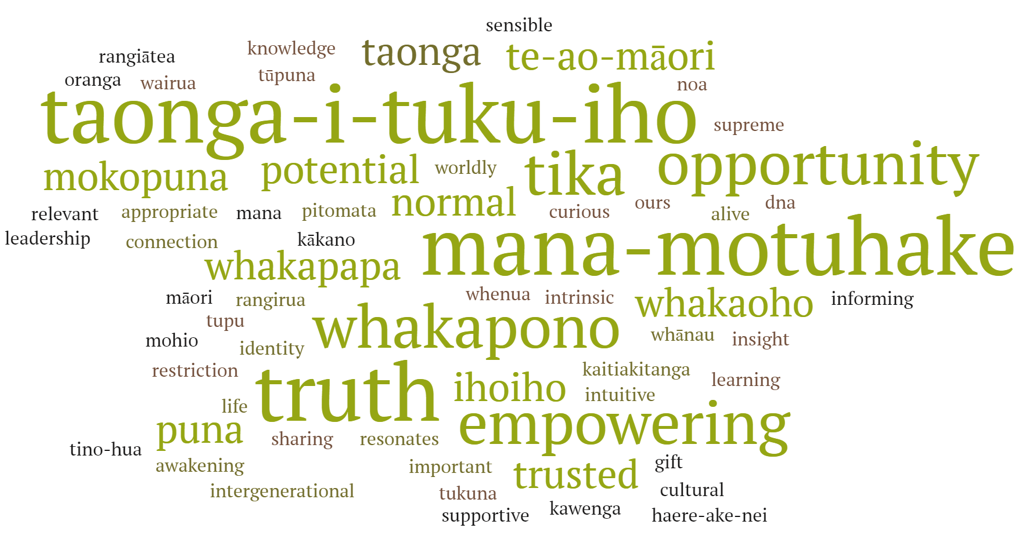
Whanaungatanga (One word to describe what mātauranga Māori means to you)

Slide 8
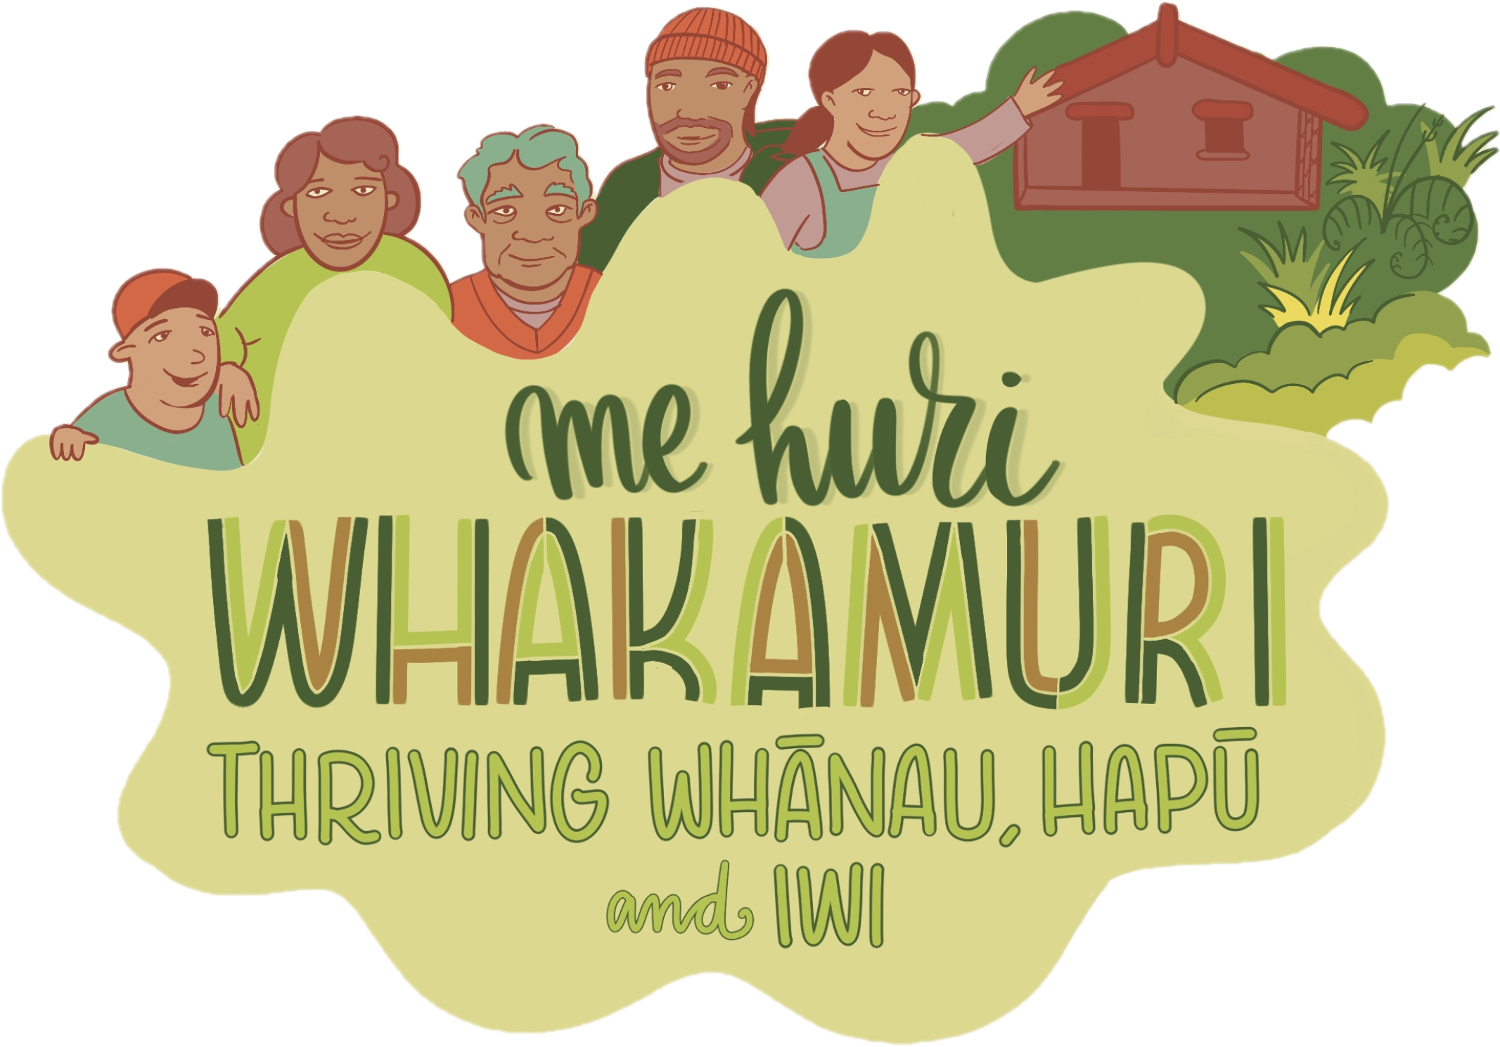

Slide 9
Me huri whakamuri - highlights
Me huri whakamuri - looking back; locating yourself with your whānau, hapū, iwi in a position of thriving prosperity and wellbeing, what has this looked and felt like? What would we carry forward?
We would take our tīpuna, their stories and the hope for the future that they carried with them. With this is the idea that our whenua would be healthy, our kai would be healthy, our rongoā would be healthy and used, and together we would be a healthy people, who work collectively to move forward. We find safety and security in the way we engage with each other and the world around us.
As is seen clearly in the past and now, mātauranga Māori cannot be captured by a single definition or thought. We would also recognise that mātauranga Māori is about our learning journey and is a place for both experts and those who need to grow that knowledge and experience.
Our whakapapa, pūrākau and histories would be available for our whānau, hapū, iwi. Barriers to finding those would be removed, we would not have to ask permission for information that tells us who we are, and we would be strengthening who we are in our cultural identity. Hapū would be living and flourishing on their hau kainga/whenua rangatira, multiple generations living together, loving each other on flourishing land that is bursting with abundance.
At the end of the day, we would have good governance, succession planning and good connections.

Slide 10
Me huri whakamuri – quotes
‘Ki te kore he whakakitenga ka mate te iwi’
‘Balance of taha tāne and taha wahine, harmony, more immersion in te ao Māori ways of living’
‘Connectedness with time, place and environment - things working in harmony with each other’
‘Safe and secure in the way we engaged with each other and the world around us learnings from my tīpuna: practical application of tikanga and kawa (confidence in knowing who we are, patience for those who come to the marae’
‘The ability to understand the past, recognise the hē (wrongs) and learn from those in order to create a better future’
‘Tino rangatiratanga, independence (from the Crown, from government from te ao Pakeha), abundance...hapū living and flourishing on our hau kainga/whenua rangatira, multiple generations living together, in love with each other on flourishing land that is bursting with abundance - kai, fresh water....’
‘You can't go back and heal but with knowledge can lead to better understand and live in a better future’
‘Sense of belonging no matter where you are’
‘Thriving future for ourselves and future generations’
‘Our tūpuna whawhai (fought) for mana motuhake and tino rangatiratanga’
‘How do we return/re-put our sovereignty as whānau, hapū, iwi, Māori over our mātauranga - to ensure it is not exploited in the future?’
‘Healthy whenua, healthy kai, healthy rongoā which leads to healthy people’
‘Kia kaua e tuku mā te moemoeā noa iho - dreaming is good but let's not just dream, let’s undertake action’
‘Recognising both sides of Mātauranga Māori. Place for experts and those who don't have that knowledge / experience’
‘Feeling of normality and comfortable with my upbringing’
‘Help kaimahi shift and operate in both worlds (Māori/Pākehā)’
‘Te reo Māori was thriving’
‘Kia tae atu tātou ki te tiketike o te maunga – it is for us to reach the pinnacle of the mountain together’
‘Our own language, our own ways to doing things - better health and wellbeing, knowing who we are, our whenua, our way of life’
‘Independence from the Crown - whānau/hapū coming together without having to ask for permission for information that tells us who we are’
‘Richness of te ao Māori’
‘Connection, marae central to way of every day living, sharing and caring’
‘Support kaimahi Māori - be aware of cultural "tax”

Slide 11
Me huri whakamuri - overarching themes
He oranga ngākau, he pikinga wairua
Tūrangawaewae; Tātai whakapapa
Whaowhia te kete mātauranga
Intergenerational, education, transmission of knowledge, taonga i tuku iho
Visionary leadership
Itiiti rearea, teitei kahikatea ka taea
A decolonised future
Hei te tau titoki; He rau ringa e oti ai
Māori mana motuhake
Insert CoLab link to Me huri whakamuri spreadsheet data
A: taha wahine
I: taha tamaiti
O: taha tāne
Tōku reo, tōku ohooho, tōku māpihi maurea
Whānau, hapū, iwi abundance and propserity
I orea te tuatara ka puta ki waho
E koekoe te kōkō, e ketekete te kākā, e kūkū te kererū;
Tikanga / mātauranga ā whānau,hapū, iwi

Slide 12
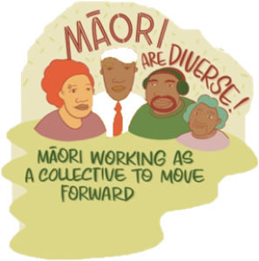
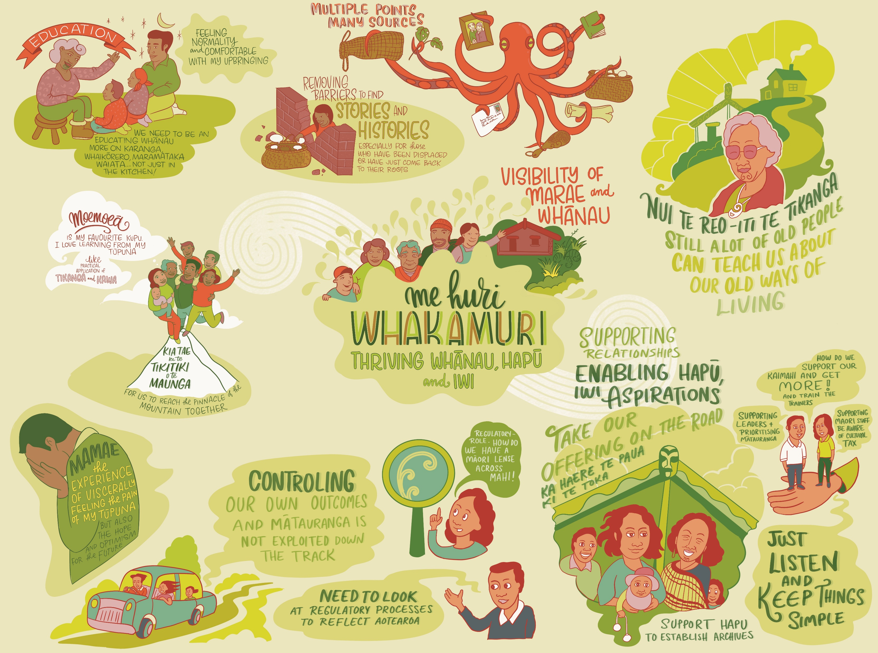
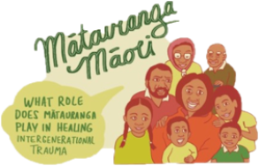
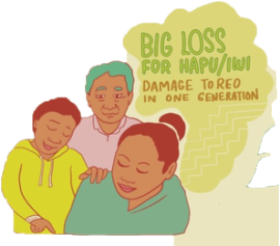
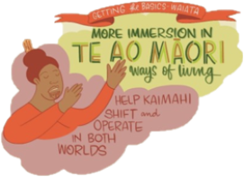
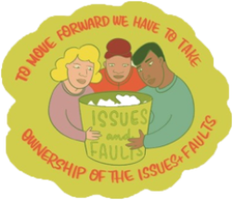
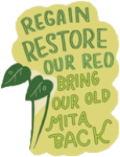
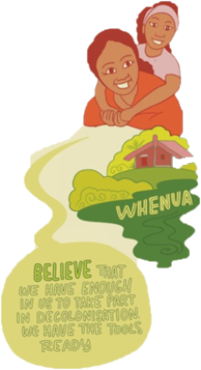
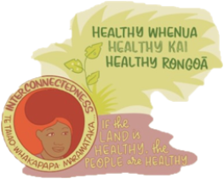

Slide 13
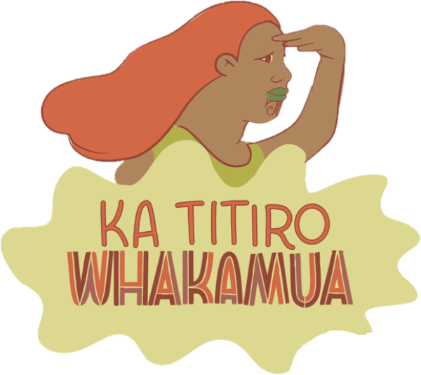

Slide 14
Ka titiro whakamua - highlights
Ka titiro whakamua - looking forward; locating yourself with your whānau, hapū, iwi in a position of thriving prosperity and wellbeing, what will this look like in a changing heritage sector landscape?
The culture and heritage sector would be made up of kaimahi who have the right skills, are enabled and empowered, and would be a sector that is known for its diversity and indigeneity – not only of people but of thought, capability and capacity. Kaimahi Māori would be able to be their whole selves in all aspects of their lives, moving intuitively between the worlds and spaces they inhabit.
Te Ao Māori intergenerational knowledge transfer is known and understood broadly and holds the integrity of taonga, taonga that are living with whānau and surrounded by their whakapapa.
Mātauranga Māori is evolving, enduring and enabled by our institutions. Our institutions are known for regularly connecting with hapū and marae, supporting the design and development of iwi repositories that are unique to them and not replications of ours, supporting taonga exchanges and exhibitions around the motu, and enabling access to and repatriation of whānau, hapū, iwi taonga – including He Whakaputanga and Te Tiriti o Waitangi.
We would be kaimahi and institutions that are flexible, fluid and adaptable. We would be easier to connect to, Māori would feel like their contributions are acknowledged and valued and that the institutions acknowledge their role and responsibility in supporting hapū, iwi, Māori transmission of mātauranga. The institutions would fully recognise Māori as tangata whenua, as mana whenua, in all of our mahi.

Slide 15

Ka titiro whakamua - quotes
‘He whakapapa kōrero, he whenua kura - using the knowledge and know how of our ancestors to create a better future. reflecting on the past, rectifying mamae and bringing the lessons of the past into our collective future’
‘The crown takes all of our Māori kaimahi time when they work for the Crown - which means their knowledge and skills can not be shared with those that they gained this knowledge for’
‘Kia whakahokia/kua whakahokia He Whakaputanga me te Tiriti o Waitangi ki kainga, hei tohu arahitanga mo nga taonga tuku Iho e pupuri ana i roto i o tatou whare pupuri taonga...That He Whakaputanga and Te Tiriti are returned home to the places they were signed as a symbol/demonstration’
‘Knowing how we add value for our users and working together to achieve’
‘Ka mua ka muri - using the lessons of the past to move into the future, never underestimating how important our past is’
‘Capability, capacity and diversity’
‘Prioritising te ao Māori’
‘Tino rangatiratanga, mana motuhake, Ao hou, Ao tawhito’
‘More kānohi ki te kānohi - purpose built spaces to enable, facilitate and encourage collective mahi and collaboration’
‘Rangatiratanga: iwi Māori not having to water down what they say’
‘Restore regular contact between marae locations and heritage institutions’
‘Changing the way institutions think about 'expertise'
‘Pupuritia i ngā tikanga o te ao tawhito’
‘At mahi - each day starts with grounding, connection, meditation and waiata - imbed te ao and mātauranga Māori into the every day of kaimahi across our organisation’
‘Re-prioritising our mahi - so that our whānau, hapū, iwi come first’
‘I will have the full ability to communicate my ideas in Te Reo’
‘More opportunities like this wānanga to contribute in a meaningful way’
‘Te reo Māori confidence and competence; cultural safety’
‘Mana motuhake over taonga and sharing it as kaitiaki with other iwi’
‘MAKING TIME for more mātauranga Māori / tikanga but time is never prioritised to achieve that’
No one size fits all, being fluid and adaptable, we don't fit on runsheets and checklists’
‘Right skills, right people, right taonga’
‘We go to where the taonga are and that is normal’
‘Having perspective and sharing voice is normal not a challenge’
‘Māori know their mātauranga and only need us to enable access and then leave them to it’
‘Sense of responsibility (to the generation before that sacrificed for this one)’
‘Not only about the material being accessible but about our institutions being accessible to our whānau, hapū, iwi’
‘Taonga exchanges... exhibitions around the motu’
‘Shared kaitiakitanga of our stories, taonga, mātauranga. Sense of responsibility for rectifying past grievances and championing of the kawa and tikanga that underpin mātauranga Māori’
‘An inclusive and expanding heritage ecosystem (hapū repositories and Crown repositories)’
‘Change the Public Records Act’

Slide 16
Ka titiro whakamua - overarching themes
Demonstrating and increasing our value-add in a changing heritage sector
Māu te kai, mā te whare takahia, māku te kauae ki te marae
Relational not transactional; social inclusion; social value
Reputation for mātauranga Māori inclusion; Choice place to work, visit, learn and grow
Kia nanao atu tātou ki ngā taonga o te ao hou, me te pupuri i ngā tikanga o te ao tawhito
Improving our regulatory / legislative space
Tiriti and Te Ao Māori led approaches, measures, impact
Collaboration under Te Tiriti o Waitangi as kaupapa centred institutions
Workforce and workplace culture creates conditions for agency and self-efficacy
Insert CoLab link to Ka titiro whakamua spreadsheet data
Mana motuhake; Toi te kupu, toi te mana, toi te whenua
Ecosystem centric; reconnecting taonga and expertise in communities, on marae
Koha atu, koha mai – understanding what we have to offer; Thinking outside the book
Empowering and enabling whānau, hapū, iwi, Māori to achieve aspirations

Slide 17
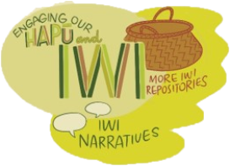
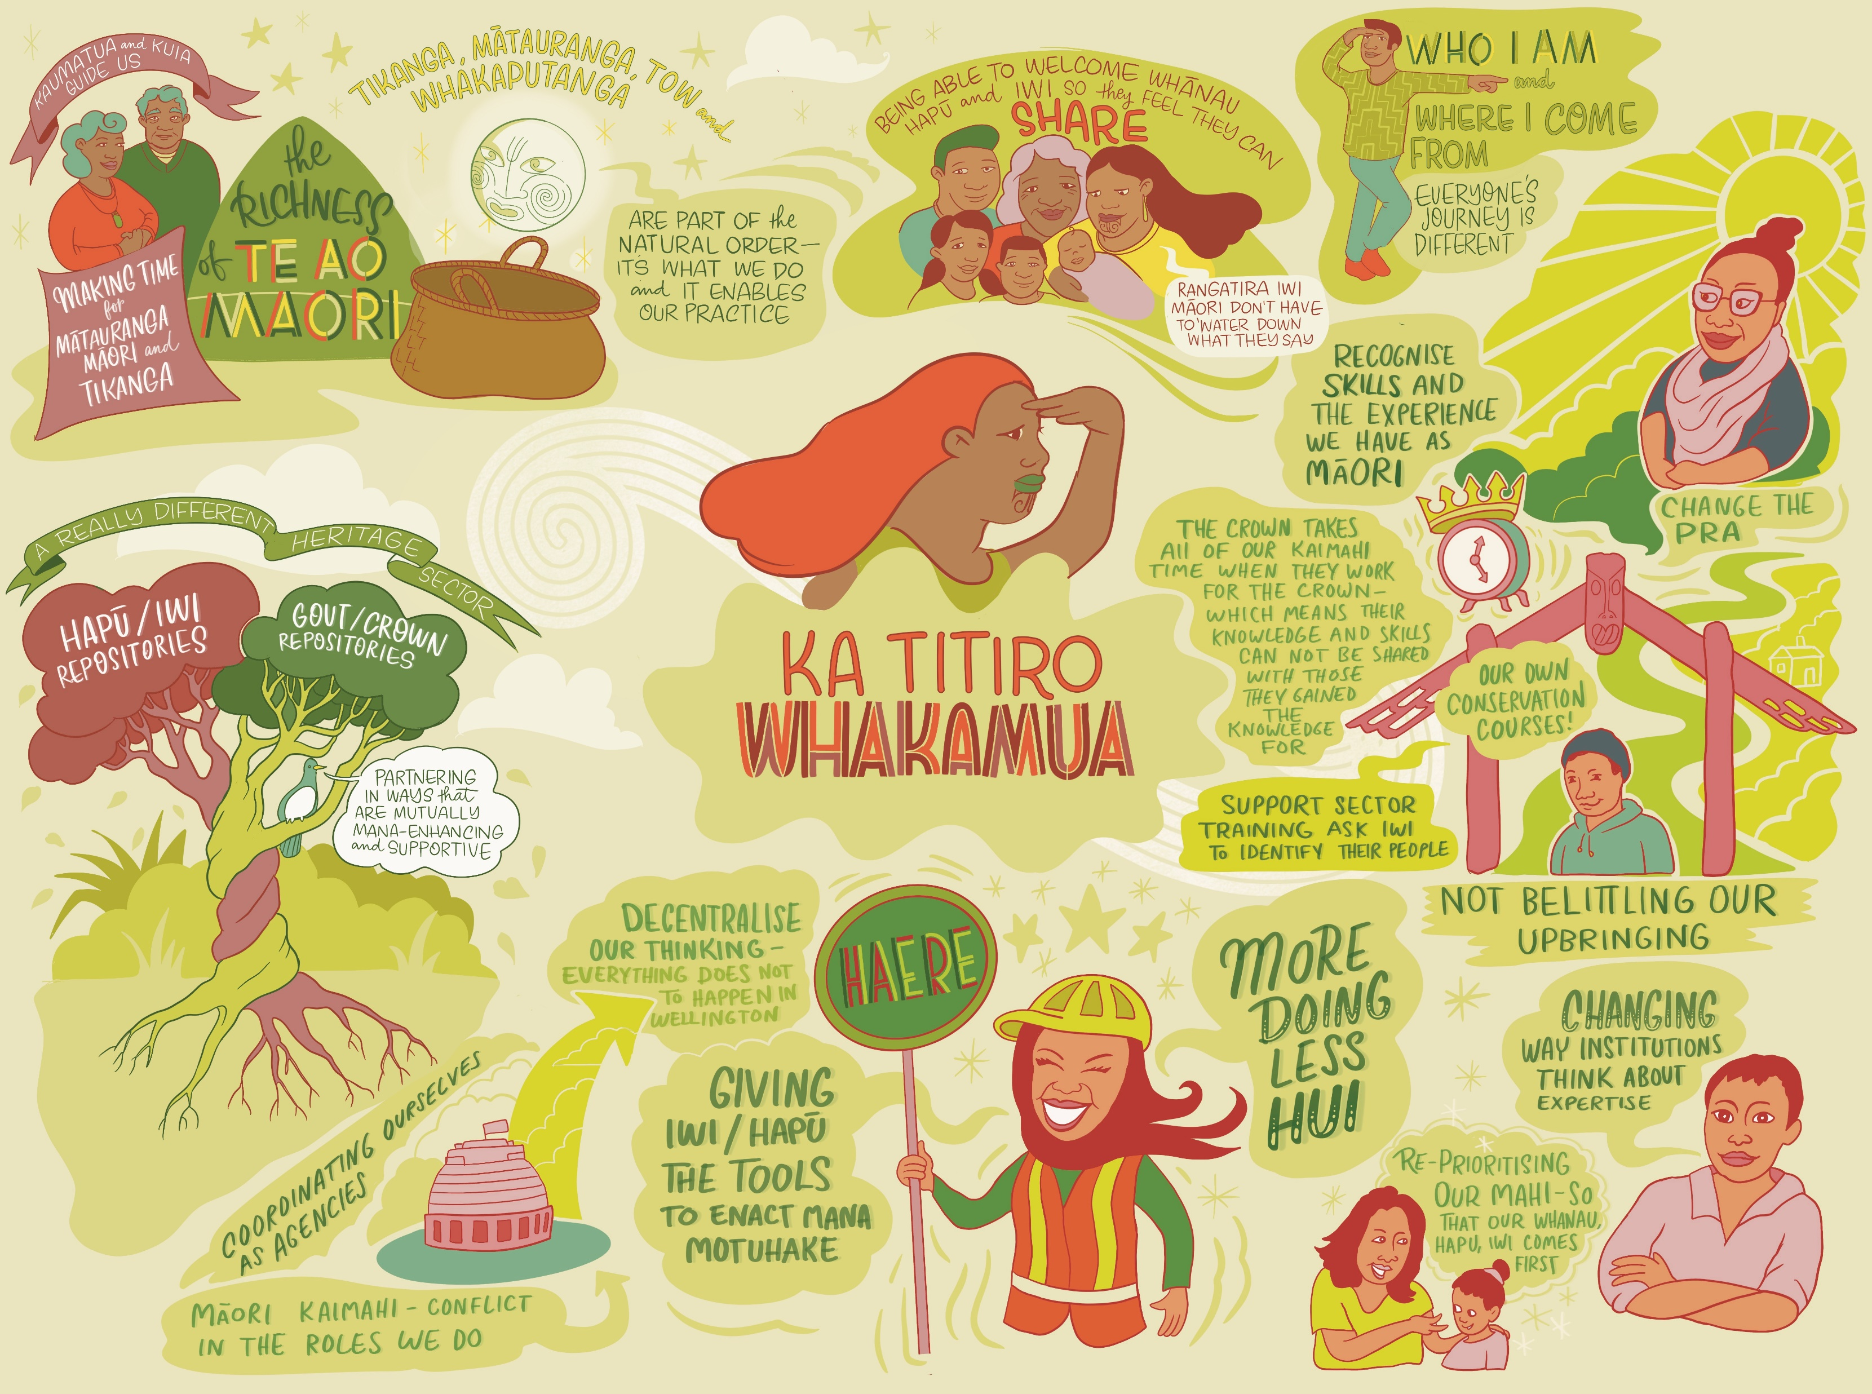

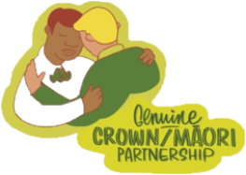
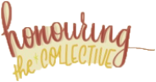
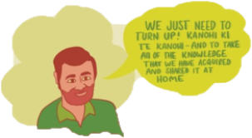
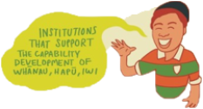
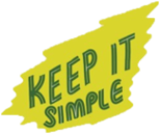
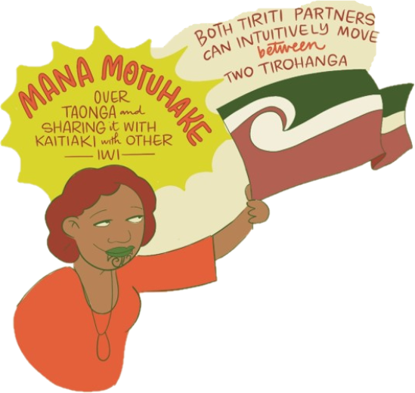
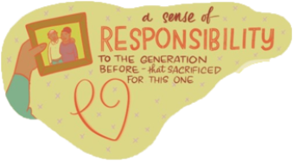
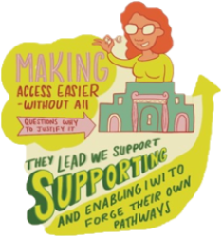
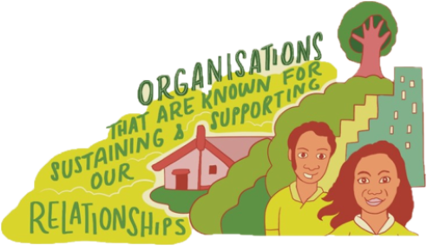

Slide 18
He whakamārama – general concepts of te reo Māori themes
He oranga ngākau, he pikinga waiora - Relationship between positive feelings and a sense of self-worth, key aspects of well-being.
Tūrangawaewae; Tātai whakapapa - Places where we feel especially empowered and connected; Identity.
Whaowhia te kete mātauranga – Enduring and evolving mātauranga Māori.
Itiiti rearea, teitei kahikatea ka taea – If a small bird can expend its energy to obtain food and achieve its goal then surely we can also with a lot of effort achieve our goals (collaboration and partnership).
Hei te tau titoki; He rau ringa e oti ai – In harmony with nature and cycles; everyone pitching in.
Māori mana motuhake – Self-determination, self-governing, control over one’s destiny.
A: taha wahine, I: taha tamaiti, O: taha tāne – The whole of self, balance between wahine/tāne.
Tōku reo, tōku ohooho, tōku māpihi maurea – Maintaining culture and heritage.
I orea te tuatara ka puta ki waho - A problem is solved by continuing to find solutions (perseverance and innovation).
E koekoe te kōkō, e ketekete te kākā, e kūkū te kererū; Tikanga / mātauranga ā whānau,hapū, iwi – Diverse realities of Māori people.
Māu te kai, mā te whare takahia, māku te kauae ki te marae – Taonga that is out of sight may be more valuable than those within one’s view.
Kia nanao atu tātou ki ngā taonga o te ao hou, me te pupuri i ngā tikanga o te ao tawhito – Let us grasp the substance of the new world, and maintain the traditions of the old world.
Mana motuhake; Toi te kupu, toi te mana, toi te whenua – Autonomy; Language, self-determination, country.
Koha atu, koha mai – Reciprocity.

Slide 19
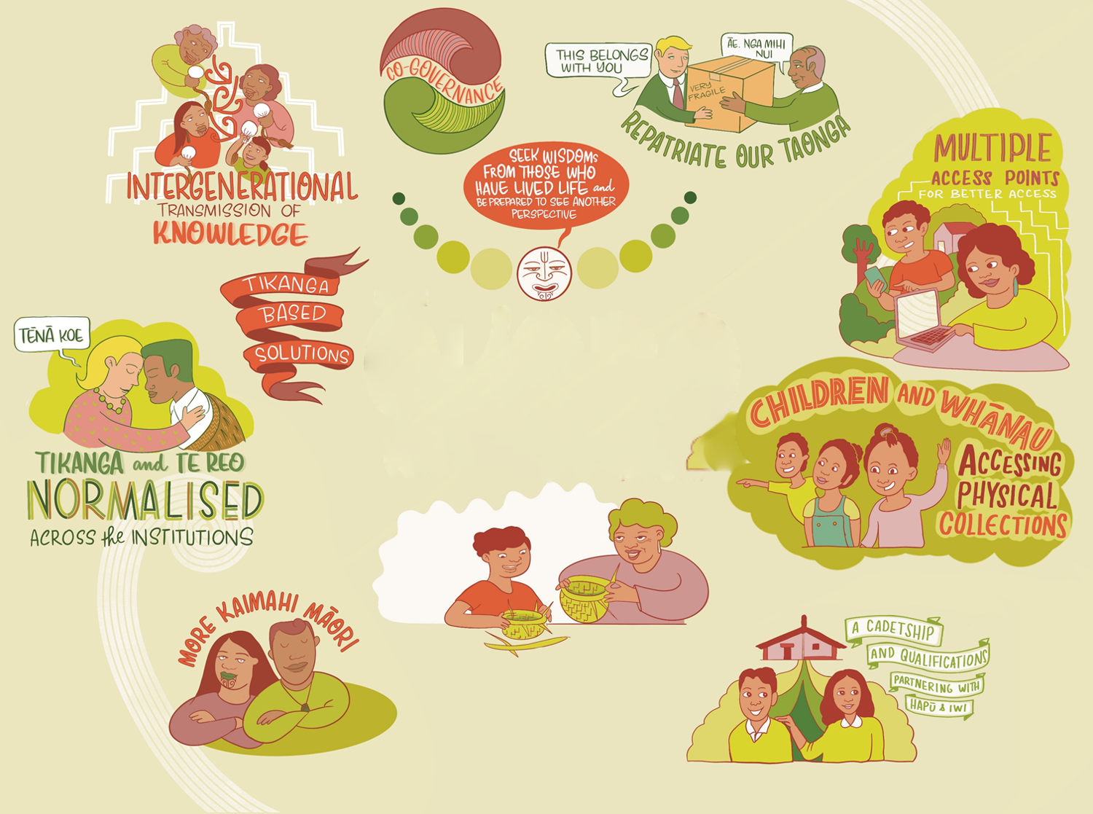
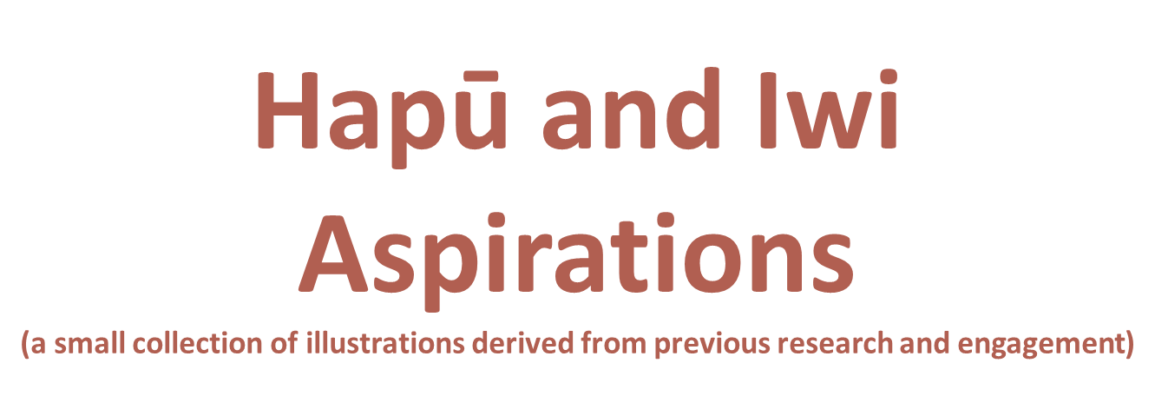

Slide 20
“
Ki te kore he whakakitenga, ka mate te iwi
If there is no vision, the people perish.
Te Puea Hērangi
(1883-1952)

Slide 21
He mihi - acknowledgements
We would like to thank:
Our talented kaimahi Māori – for your whanaungatanga, whakaaro, expertise, kōrero and making this wānanga possible.
Megan, Stephen and the League – for their creativity, passion and support.
SLT – for your demonstrated commitment to this important kaupapa, and showing us a different side of your incredible personalities.
Arihia, Karli and Jayson – our hāpai ō ki muri, coordinating scribe power, analysis and technology assistance.
Te Hīnaki – for their guidance, collaborative effort and facilitation founded on pono, koa and aroha.

